Slide 1

Artificial Intelligence Assignment 1 – Final Delivery
Group 07
Carolina Rosemback Guilhermino, up201800171
José Eduardo Henriques, up201806372
Miguel Carreira Neves, up201608657

Slide 2

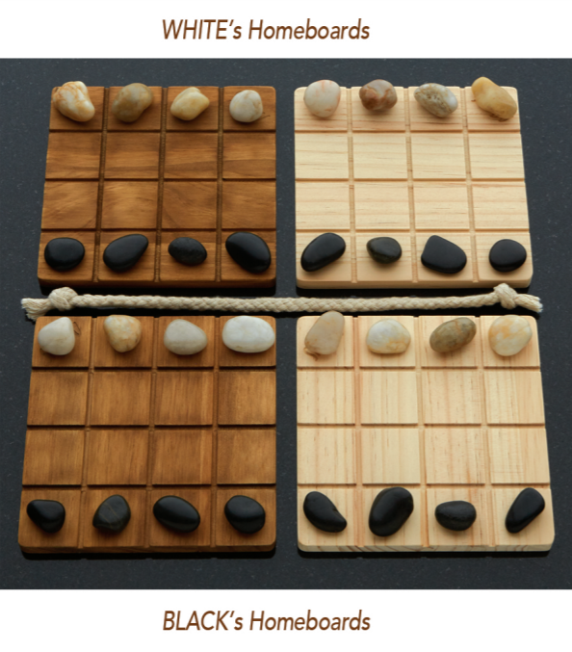
Project Specification
Two-Player Adversarial Board Game: Shobu
Turn based game, where each turn is comprised of two moves: first one Passive move and then one Aggressive move.
The passive move must be played on one of the player’s two homeboards. The player chooses one of their colour pieces and moves it into any direction inside the board, up two spaces, without pushing or jumping over any piece.
The aggressive move must be made in the same direction and number of spaces as the passive move, on one of the opposite colour boards as the one chosen in the passive move. Additionally, the aggressive move can push, at most, one piece, of the opponent colour. If a piece is pushed off the board, that piece is removed from the game.
The game’s objective is to remove all opponent pieces from one board. First one to do so wins the game.
In this project, the aim is to implement this game with PvP, PvC and CvC modes. The Computer should be provided with an AI, using Minimax search methods with different depth and αβ cuts, ensuring different difficulty levels.
figure 1- game board
Fig. 1 – Shobu Initial Boards

Slide 3

Search Problem Formulation
State Representation:
4-Dimensional matrix M[ H[ B[4,4], B[4,4] ], H[ B[4,4], B[4,4] ] ]. State M is a matrix consisting of two H matrices. H represents a player’s homeboard, consisting of two B matrices. B represents a board, consisting of a 4x4 matrix. A board is filled with ‘B’, ‘W’ or ‘ ‘ chars, representing a black piece, a white piece and an empty space, respectively.
Initial State:
Each board’s top row is filled with white pieces, bottom row is filled with black pieces and the rest with empty spaces (as shown in Fig. 1)
Objective State:
Any state containing a board with only black pieces (and empty spaces), assuming the black player’s perspective.
Operators:
updateBoard(passive_piece, aggressive_piece, offset, piece, other_piece)
Operator Preconditions:
Both functions legalPassiveMoves and legalAgressiveMoves must return non-empty amount of options so that a turn can be considered valid.

Slide 4
Search Problem Formulation
Operator Preconditions (continuation):
“legalPassiveMoves”, returns which pieces can perform a passive move, for a given movement and board colour.
def legalPassiveMoves(self, color_side, row_index, col_index):
options = []
for i in range(row_index - 2, row_index + 3): # 2 rows behind, 2 rows ahead
if(i < 0 or i > 3): continue
for j in range(col_index - 2, col_index + 3): # 2 cols behind, 2 cols ahead
if(j < 0 or j > 3): continue
if(((i == row_index - 2 or i == row_index + 2) and (j == col_index - 1 or j == col_index + 1)) or
(((i == row_index - 1 or i == row_index + 1) and (j == col_index - 2 or j == col_index + 2)))): continue
if(i == row_index - 2 or i == row_index + 2 or j == col_index - 2 or j == col_index + 2):
middle_i = int((row_index + i)/2)
middle_j = int((col_index + j)/2)
if(self.board.boards[self.player][color_side][middle_i][middle_j] != ' ‘): continue
if(self.board.boards[self.player][color_side][i][j] == ' ‘): options.append([i, j])
return options

Slide 5
Search Problem Formulation
Operator Preconditions (continuation):
“legalAgressiveMoves” returns which pieces can perform an aggressive move, for a given movement and board colour.
def legalAgressiveMoves(self, offset, other_color, piece, other_piece):
options1 = []
options2 = []
for row in range(4):
for col in range(4):
if(self.board.boards[0][other_color][row][col] == piece):
if(self.verifyDirection(0, other_color, row, col, offset, piece, other_piece)):
options1.append([row, col])
if(self.board.boards[1][other_color][row][col] == piece):
if(self.verifyDirection(1, other_color, row, col, offset, piece, other_piece)):
options2.append([row, col])
return [options1, options2]

Slide 6
Search Problem Formulation
Operator Effects:
def updateBoard(self, passive_piece, agressive_piece, offset, piece, other_piece):
self.board.boards[passive_piece[0]][passive_piece[1]][passive_piece[2]][passive_piece[3]] = ' ‘
self.board.boards[passive_piece[0]][passive_piece[1]][passive_piece[2] + offset[0]][passive_piece[3] + offset[1]] = piece
self.board.boards[agressive_piece[0]][agressive_piece[1]][agressive_piece[2]][agressive_piece[3]] = ' ‘
v_dir, h_dir = 0
if(offset[0] != 0): v_dir = int(offset[0] / abs(offset[0]))
if(offset[1] != 0): h_dir = int(offset[1] / abs(offset[1]))
n_iter = max(abs(offset[0]), abs(offset[1]))
pushing = False
for i in range(1, n_iter + 1):
if(self.board.boards[agressive_piece[0]][agressive_piece[1]][agressive_piece[2] + i*v_dir][agressive_piece[3] + i*h_dir] == other_piece): pushing = True
if(i == n_iter): self.board.boards[agressive_piece[0]][agressive_piece[1]][agressive_piece[2] + i*v_dir][agressive_piece[3] + i*h_dir] = piece
else: self.board.boards[agressive_piece[0]][agressive_piece[1]][agressive_piece[2] + i*v_dir][agressive_piece[3] + i*h_dir] = ' '
if(pushing): # if there's enemy piece to be pushed
if(agressive_piece[2] + offset[0] + v_dir in [0, 1, 2, 3] and agressive_piece[3] + offset[1] + h_dir in [0, 1, 2, 3]):
self.board.boards[agressive_piece[0]][agressive_piece[1]][agressive_piece[2] + offset[0] + v_dir][agressive_piece[3] + offset[1] + h_dir] = other_piece

Slide 7
Search Problem Formulation
Operator Costs:
1
Evaluation Function:
1. Get List of Legal Moves: Gets all legal moves and returns four lists with passive and agressive from each player
2. countNumPieces: Evaluate the number of pieces on each board (More White Pieces -> Positive Number else -> Negative)
3. calcDiffNumPieces: Calculate the value of the pieces of player, used to evaluate the game when the computer is on easy mode
4. calcPoints: Calculate Quadratic Sum on each Board. Used to evaluate the game when the computer is on medium mode. When the computer is on hard mode, is also consider de vulnerabilities of the pieces

Slide 8
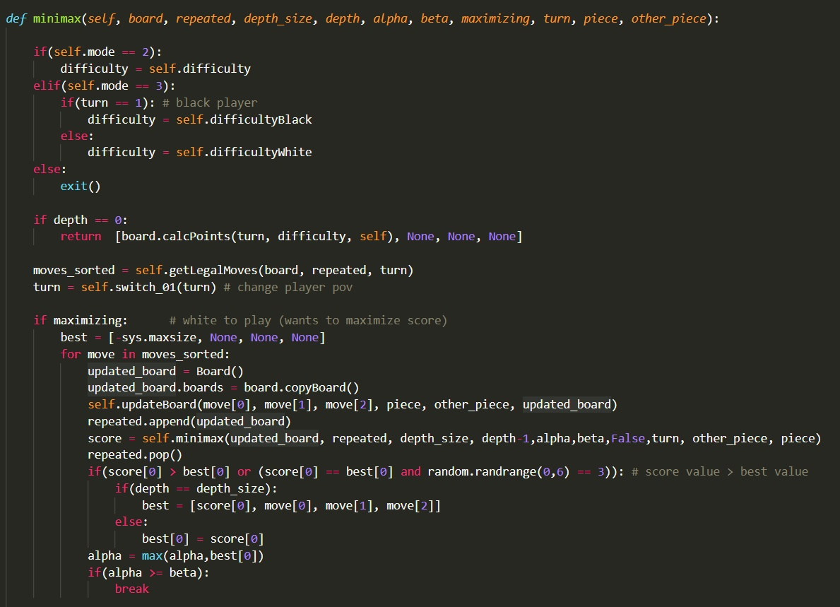
Implemented Algorithms
Considering our projects needs, we used the Minimax algorithm to evaluate the plays When in computer vs computer mode, minimizing or maximazing the total score of a player, given a list of the legal moves.
Figure 2 - part of minimax

Slide 9
Experimental Implementations
During the Project’s implementation, we encountered some issues regarding the code efficiency, mostly When we implemented the Minimax algorithm.
One of our tries, was to sort the list of legal moves using the sorted() function by associating it with a function to calculate the points of a move as the key for the sorted function. However, this took a large amout of elapsed time (e.g for a player turn, it sometimes took about 15 to 25 seconds to do a move). So we decided against it, by choosing another approach.

Slide 10
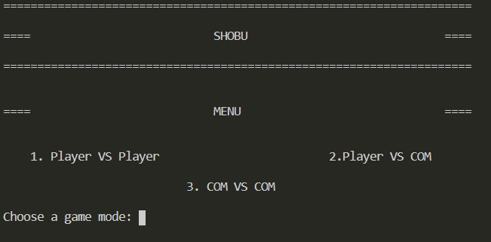
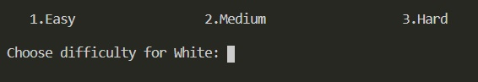
Implemented Work
The language of choice is Python.
The code is in a single file, separated in two classes: Board and GameLogic.
We also implemented a test file.
PvP mode is fully functional with a clean UI.
PvC is fully functional, you can also choose the difficulty of the computer.
CvC is also fully functional, being able to choose between 3 modes: easy, medium and hard.
Figure 3 – Main Menu

